Slide 1


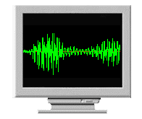



Server
voice
Pre-Processing, SVM Server
Voice File
Connection Server
Text /
Recognized emotions

Slide 2
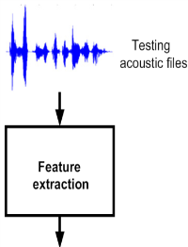

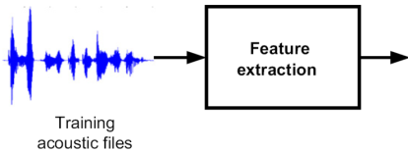
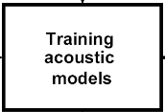


Testing acoustic files
PLP
Recognized emotions
PLP
SVM

